Slide 1
Introduction to Embedded and Robotics Programming
Cosmin Bonchis, Alin Brindusescu, Theodor Grumeza
Notes:
*** Version of 2017 ***
1

Slide 2



Introduction to Embedded and Robotics Programming
Lector Dr. Cosmin Bonchiș
Affiliations:
West University of Timisora
Contact: cosmin.bonchis@e-uvt.ro
Dipl. Ing. Alin Brîndușescu
Affiliations:
Elektrobit
West University of Timisora
Contact: alin.brindusescu77@e-uvt.ro
Theodor Grumeza
Affiliations:
West University of Timisora
Contact: theodor.grumeza@e-uvt.ro

Slide 3
Introduction to Embedded and Robotics Programming
Course Objectives
Develop the minimum necessary skill for reading an electronic circuit
Discuss major components of an embedded system
Solve well defined problems on an embedded platform
Get familiar with tools used for embedded development
Understand the basic building blocks of a robotic system
© University of West & Elektrobit (EB) 2018
3

Slide 4
Introduction to Embedded and Robotics Programming
Learning Outcomes
Learn how to read and replicate a simple electronic circuit
Understand what is a microcontroller and an embedded system
Become familiar with embedded programming environment
Understand key concepts of embedded systems: I/O, timers, interrupts, etc.
Learn embedded systems debugging techniques
Understand what are robots and the building block of a robotic system
Apply the embedded programming skills for driving a small robotic system
© University of West & Elektrobit (EB) 2018
4

Slide 5
Introduction to Embedded and Robotics Programming
Course Structure
W1: Introduction and …
W2: W3: W4: EMBEDDED C …
W5:Basic Electronics II, Microcontroller Architecture
W6: I/O module , Interruptions
W7: Analog to Digital Converter, Robotics Basics
W8: Actuators and Drivers
W9-W13: Project
W14: Project presentation
© University of West & Elektrobit (EB) 2018
5

Slide 6
Introduction to Embedded and Robotics Programming
Course Structure
Weekly laboratory class – 3 Working Groups
W2 - W9
30 minutes theoretical presentation
1 hour experiments
W10 – W 13
Project work
W14
Project presentation
© University of West & Elektrobit (EB) 2018
6

Slide 7
Introduction to Embedded and Robotics Programming
Grades
Blue team
no class presence required
exam from the theory material provided in week 7
max grade 7
Green team:
class presence and involvement required
based on the evaluation of the final project from week 14.
Mandatory requirement for both teams: own github.com or bitbucket.com account with all the code from laboratory committed
How to fail the exam:
Chose the green team and come to the class and disturb your colleagues who want to experiment more
© University of West & Elektrobit (EB) 2018
7

Slide 8
Introduction to Embedded and Robotics Programming
Laboratory Experiments and Project
Based on Arduino Uno R3
Plenty of peripherals available
Robotics Kit
© University of West & Elektrobit (EB) 2018
8

Slide 9
Introduction to Embedded and Robotics Programming
Project Ideas
Robotics
Drive the robotic platform trough the environment using ultrasound sensors
IoT
Door opening counter with digital display
Windows breaking alarm
Digital thermometer
Open for suggestions
© University of West & Elektrobit (EB) 2018
9

Slide 10
Introduction to Embedded and Robotics Programming
Basic Electronics For Programmers
© University of West & Elektrobit (EB) 2018
10

Slide 11
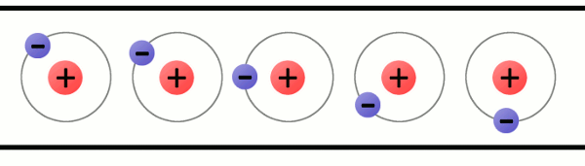
Introduction to Embedded and Robotics Programming
Basic Electronics For Programmers
Electric current
Flow of electric charge
Symbol: I
Ampere (A) as measuring unit
Measurement tool: Ammeter, Galvanometer, rom: Ampermetru
© University of West & Elektrobit (EB) 2018
11
Notes:
All our electric and electronic circuits need electric current to function. The electric current is the flow of the electric charge.
Because electricity is abstract and it can not be so easy visualized you can imagine the flow of electrons as the water flowing through the pipes.
Example with the notation of the current and explain that if the value of I is negative basically the current flows in the opposite direction
11

Slide 12
Introduction to Embedded and Robotics Programming
Basic Electronics For Programmers
Type of electric current: AC - alternative current
© University of West & Elektrobit (EB) 2018
12

Slide 13
Introduction to Embedded and Robotics Programming
Basic Electronics For Programmers
Type of electric current: DC - direct current
© University of West & Elektrobit (EB) 2018
13

Slide 14
Introduction to Embedded and Robotics Programming
Basic Electronics For Programmers
Where do we have AC and where DC?
What type of electric current are using our gadgets?
© University of West & Elektrobit (EB) 2018
14

Slide 15
Introduction to Embedded and Robotics Programming
Basic Electronics For Programmers
Voltage
Potential difference
Pressure to push the electrons to move
Symbol: U
Volt (V) as measuring unit
Measurement tool: Voltmeter, Galvanometer, rom: Ampermetru
© University of West & Elektrobit (EB) 2018
15
Notes:
The voltage between two points is equal to the work done per unit of charge against a static electric field to move a test charge between two points.
Voltage/potential difference can be compared to water stored in a tank. The larger the tank, and the greater its height (and thus its potential velocity), the greater the water’s capacity to create an impact when a valve is opened and the water (like electrons) can flow.
15

Slide 16
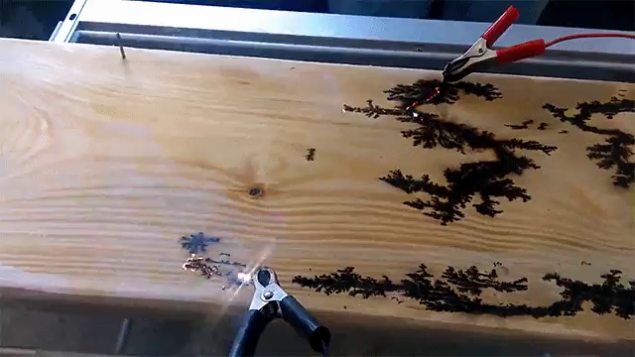
Introduction to Embedded and Robotics Programming
Basic Electronics For Programmers
© University of West & Elektrobit (EB) 2018
16
Notes:
Why not a direct line between the 2 electrodes? Because electric current is finding the path with less resistance (lazy path).
16

Slide 17

Introduction to Embedded and Robotics Programming
Basic Electronics For Programmers
Ohm’s Law
Current flowing through a conductor is directly proportional with the voltage
Resistance (R) – the constant of proportionality – measured in ohms (Ω)
$$I=\frac{U}{R}$$
© University of West & Elektrobit (EB) 2018
17
Notes:
It is an empirical law, the form we are using is a reformulation made by Kirchhoff. It will not always hold: Any given material will break down under a strong-enough electric field, and some materials of interest in electrical engineering are "non-ohmic" under weak fields.
Temperature has also an effect since the resistance is temperature dependent.
Looking from the point of view of the energy source any circuit can be reduced to this simple form.
17

Slide 18
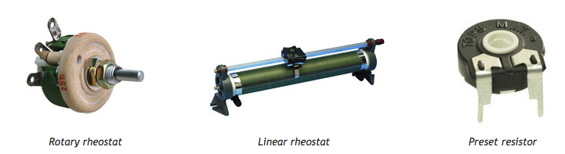
Introduction to Embedded and Robotics Programming
Basic Electronics For Programmers
Resistors
Passive components that are obeying Ohm’s law
Designed to have a specific resistance value R
Common usage: reduce current flow, divide voltages, terminate transmission lines, …
© University of West & Elektrobit (EB) 2018
18
Notes:
Rheostat are basically potentiometers for higher currents. Rheostats were often used as power control devices, for example to control light intensity (dimmer), speed of motors, heaters and ovens. Nowadays they are not used for this function anymore. This is because of their relatively low efficiency.
18

Slide 19
Introduction to Embedded and Robotics Programming
Basic Electronics For Programmers
Example 1:
Example 2:
© University of West & Elektrobit (EB) 2018
19
Notes:
E1: 120 KO, 5% tolerance
E2: 130 O, 1% tolerance
19

Slide 20
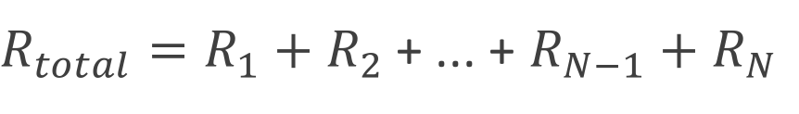
Introduction to Embedded and Robotics Programming
Basic Electronics For Programmers
Serial circuit of Resistors
+ ... +
© University of West & Elektrobit (EB) 2018
20

Slide 21
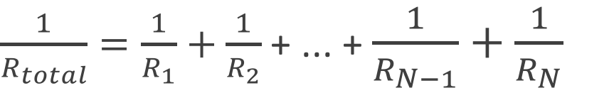
Introduction to Embedded and Robotics Programming
Basic Electronics For Programmers
Parallel circuit of Resistors
+ ... +
© University of West & Elektrobit (EB) 2018
21

Slide 22
Introduction to Embedded and Robotics Programming
Basic Electronics For Programmers
Resistor networks
R₁+R₂+R₃||(R₄+R₅+R₆||(R₇+R₈+R₉))
© University of West & Elektrobit (EB) 2018
22
Notes:
R₁+R₂+R₃||(R₄+R₅+R₆||(R₇+R₈+R₉)).
22

Slide 23
Introduction to Embedded and Robotics Programming
Basic Electronics For Programmers
How to use a multimeter: Measuring Voltage
© University of West & Elektrobit (EB) 2018
23

Slide 24
Introduction to Embedded and Robotics Programming
Basic Electronics For Programmers
How to use a multimeter: Measuring Current Intensity
© University of West & Elektrobit (EB) 2018
24

Slide 25
Introduction to Embedded and Robotics Programming
Basic Electronics For Programmers
How to use a multimeter: Measuring Resistors
© University of West & Elektrobit (EB) 2018
25

Slide 26
Introduction to Embedded and Robotics Programming
Basic Electronics For Programmers
How to use a multimeter:
Always remember:
voltage in parallel, current intensity in series
don’t measure the other elements (resistors, diodes) when under power
© University of West & Elektrobit (EB) 2018
26
Notes:
26

Slide 27
Introduction to Embedded and Robotics Programming
Basic Electronics For Programmers
More to read:
https://kaiserscience.wordpress.com/physics/electromagnetism/electric-current/
https://learn.sparkfun.com/tutorials/resistors
https://learn.sparkfun.com/tutorials/how-to-use-a-multimeter
© University of West & Elektrobit (EB) 2018
27

Slide 28
Happy Hacking!
C U next Week!
Basic Electronics For Programmers
Introduction to Embedded and Robotics Programming
© University of West & Elektrobit (EB) 2018
28

